Slide 1
( near periphery of cell )

Slide 2
( central )
( special junctions between cells )

Slide 4
( surrounds individual muscles and groups of muscles )
( surrounds muscles )
( surrounds fasciculi )
( surrounds muscle fibers )

Slide 7
(thin)

Slide 10
Triad

Slide 12
( sarcolemma )

Slide 13
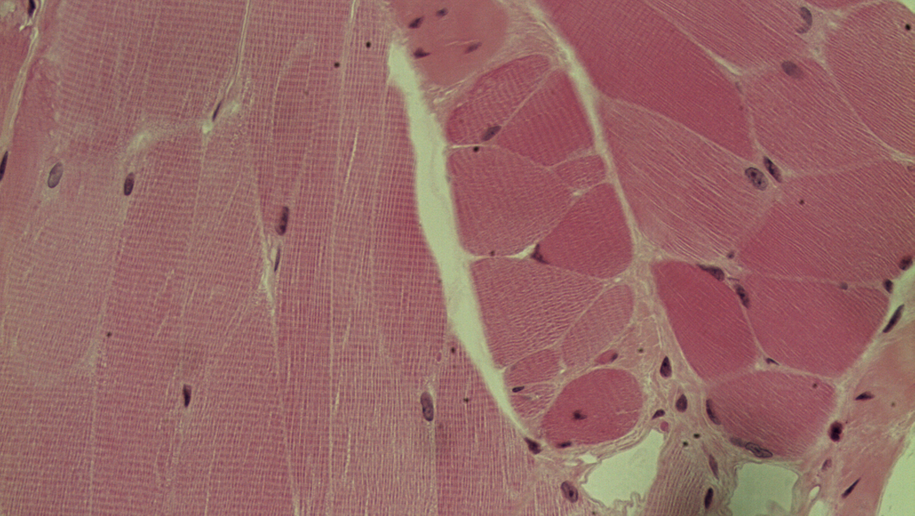
Slide M-1 = Skeletal Muscle

Slide 14
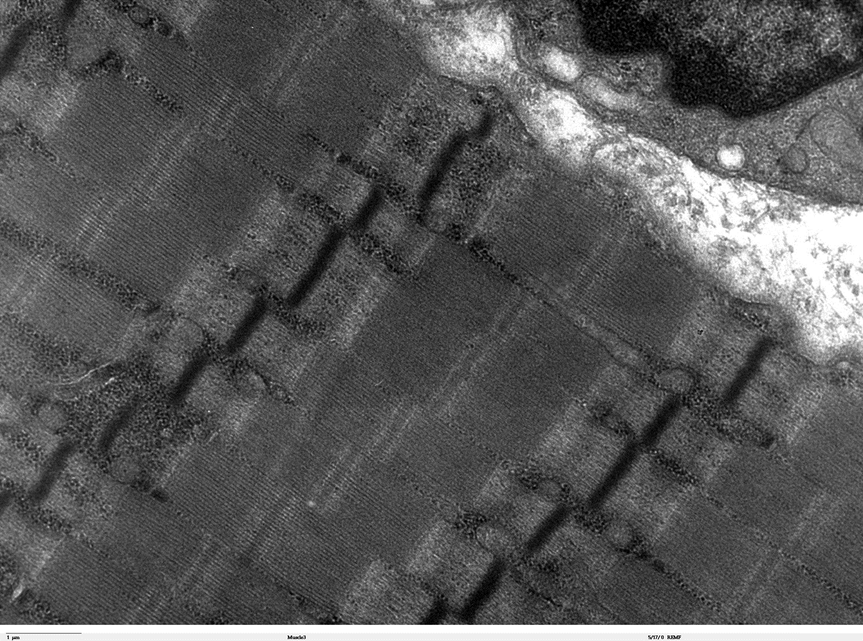
Slide M-2 = Skeletal Muscle Tissue

Slide 15
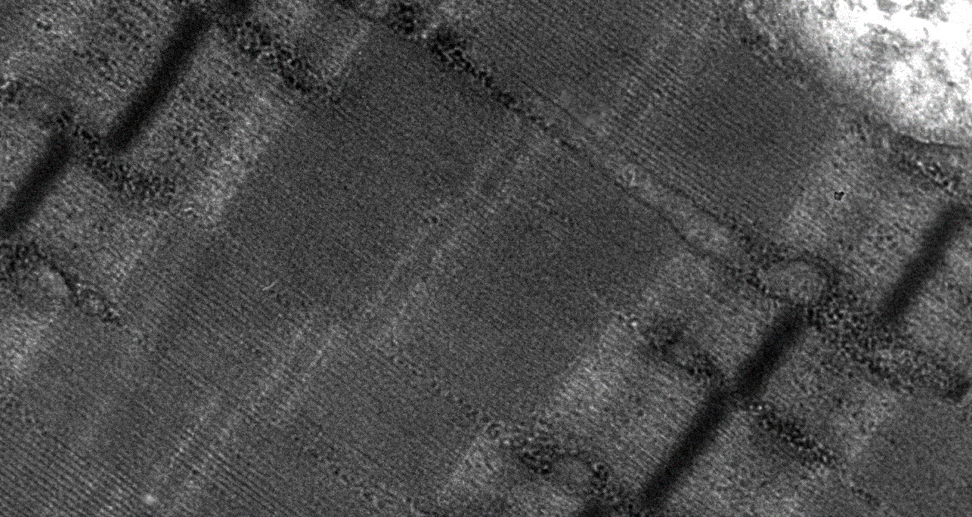
Slide M-3 = Skeletal Muscle Tissue

Slide 16
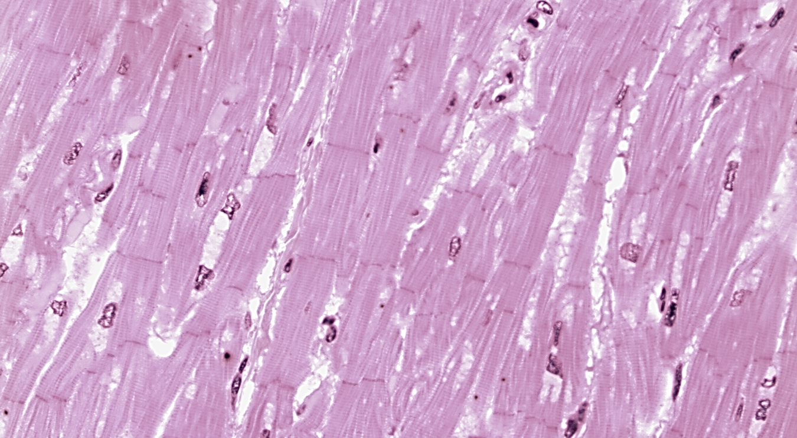
Slide M-4 = Cardiac Muscle Tissue

Slide 17
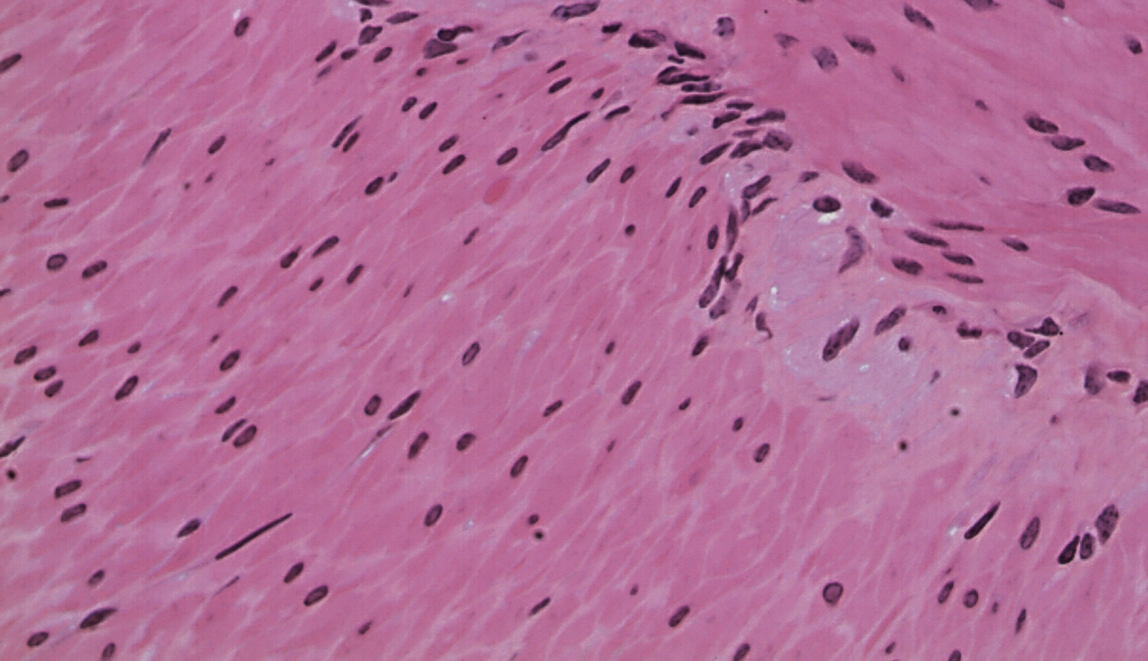
Slide M-5 = Smooth Muscle Tissue

